Slide 1
CSE302-Software Quality Engineering A model for SQA defect removal effectiveness and cost
Instructor: Sobia Usman
Assistant Professor
CS - CUI, LHR

Slide 2
Factors affecting intensity of Quality Assurance Activities in the Development Process
Project life cycle quality assurance activities are process oriented, in other words, linked to completion of a project phase, accomplishment of a project milestone, and so forth.
The quality assurance activities will be integrated into the development plan that implements one or more software development models – the waterfall, prototyping, spiral, object-oriented or other models.

Slide 3
Factors affecting intensity of Quality Assurance Activities in the Development Process
Quality assurance planners for a project are required to determine:
The list of quality assurance activities needed for a project.
For each quality assurance activity:
– Timing
– Type of quality assurance activity to be applied
– Who performs the activity and the resources required. It should be noted that various bodies may participate in the performance of quality assurance activities: development team and department staff members together with independent bodies such as external quality assurance team members or consultants
– Resources required for removal of defects and introduction of changes.

Slide 4
Factors affecting the required intensity of quality assurance activities
Project factors:
Magnitude of the project
Technical complexity and difficulty
Extent of reusable software components
Severity of failure outcomes if the project fails
Team factors:
Professional qualification of the team members
Team acquaintance with the project and its experience in the area
Availability of staff members who can professionally support the team
Familiarity with the team members, in other words the percentage of new staff members in the team

Slide 5
Example 1
A software development team has planned the quality assurance activities for its new consumer club project. The current project contract, signed with a leading furniture store, is the team’s 11th consumer club project dealing in the last three years. The team estimates that about seven man-months need to be invested by the two team members assigned to the project, whose duration is estimated at four months. It is estimated that a reusable components library can supply 90% of the project software.
Three quality assurance activities were planned by the project leader.

Slide 6
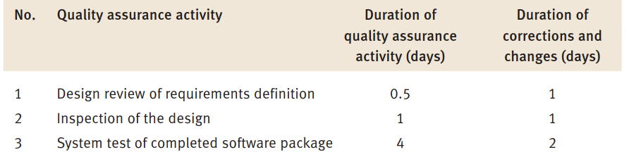
Duration of quality assurance activities – the consumer club example

Slide 7
Consumer club example
The main considerations affecting this plan are:
Degree of team acquaintance with the subject
High percentage of software reuse
Size of the project (in this case, medium)
Severity of failure results if the project fails.

Slide 8
Verification, Validation and Qualification
Three aspects of quality assurance of the software product (a report, code, etc.) are examined under the rubrics of verification, validation and qualification.
IEEE Std 610.12-1990 (IEEE, 1990) defines these aspects as follows:
“Verification – The process of evaluating a system or component to determine whether the products of a given development phase satisfy the conditions imposed at the start of that phase.”

Slide 9
Validation and Qualification
“Validation – The process of evaluating a system or component during or at the end of the development process to determine whether it satisfies specified requirements.”
“Qualification – The process used to determine whether a system or component is suitable for operational use.”

Slide 10
A Model for SQA defect removal effectiveness and cost
The model deals with two quantitative aspects of an SQA plan consisting of several defect detection activities:
The plan’s total effectiveness in removing project defects.
The total costs of removal of project defects

Slide 11
The data
The application of the model is based on three types of data
Defect origin distribution
Defect removal effectiveness
Cost of defect removal

Slide 12
Defect origin distribution
Defect origins (the phase in which defects were introduced) are distributed throughout the development process, from the project’s initiation to its completion
A characteristic distribution of software defect origins, based on Boehm (1981) and Jones (1996), is shown in Table 1.

Slide 13
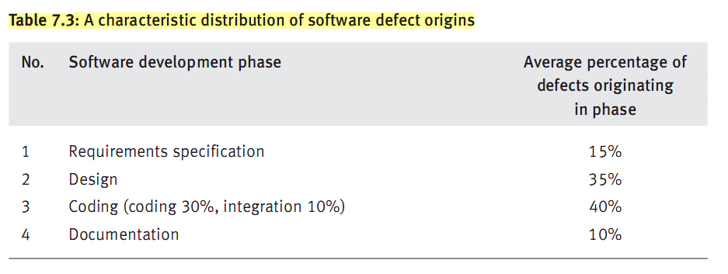
Defect origin distribution

Slide 14
Defect Removal Effectiveness
It is assumed that any quality assurance activity filters (screens) a certain percentage of existing defects.
The percentage of removed defects is somewhat lower than the percentage of detected defects as some corrections are ineffective.
The remaining defects, those undetected and uncorrected, are passed to successive development phases.

Slide 15
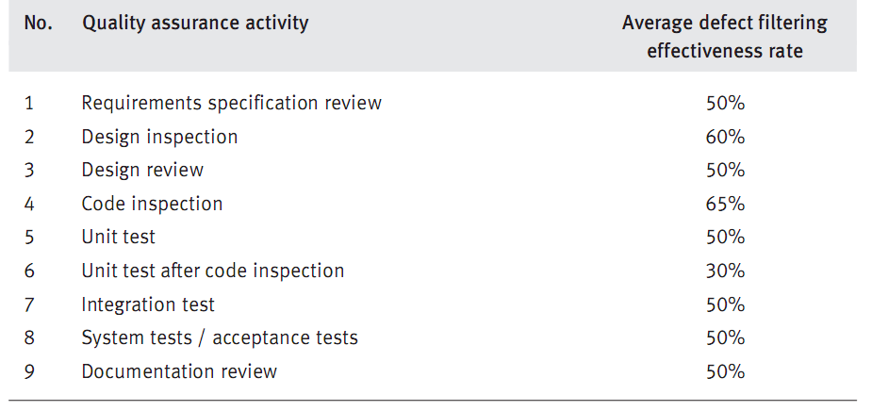
Defect removal effectiveness
Typical average defect filtering effectiveness rates for the various
quality assurance activities, by development phase, based on Boehm and Jones are listed in Table below.

Slide 16
Cost of defect removal
Data collected about development project costs show that the cost of removal of detected defects varies by development phase, while costs rise substantially as the development process proceeds.
For example, removal of a design defect detected in the design phase may require an investment of 2.5 working days; removal of the same defect may require 40 working days during the acceptance tests.

Slide 17
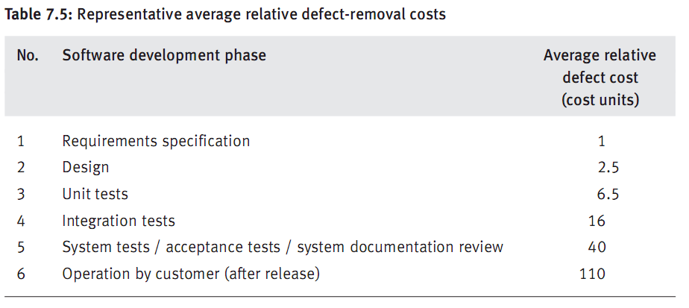
Cost of defect removal
Representative average relative defect-removal costs, based on
Boehm and Pressman studies are shown in Table below

Slide 18
The Model
Model is based on following assumptions:
Development process is linear, sequential following waterfall model
There is a number of new defects introduced in each phase
Review and test software quality assurance activities serve as filters, removing a percentage of defects and letting the rest pass to next development phase.
At each phase, incoming defects are the sum of those not removed plus new defects in current phase
Remaining defects are passed to the customer. (this is the heaviest cost for defect removal)

Slide 19
Model - Parameters
The models we show use these parameters:
POD – Phase originated defects
PD – Passed defects (from former phases)
%FE - % of filtering effectiveness
RD – Removed defects
CDR – Cost of defect removal
TRC – Total Removal Costs
TRC = RD × CDR.

Slide 20
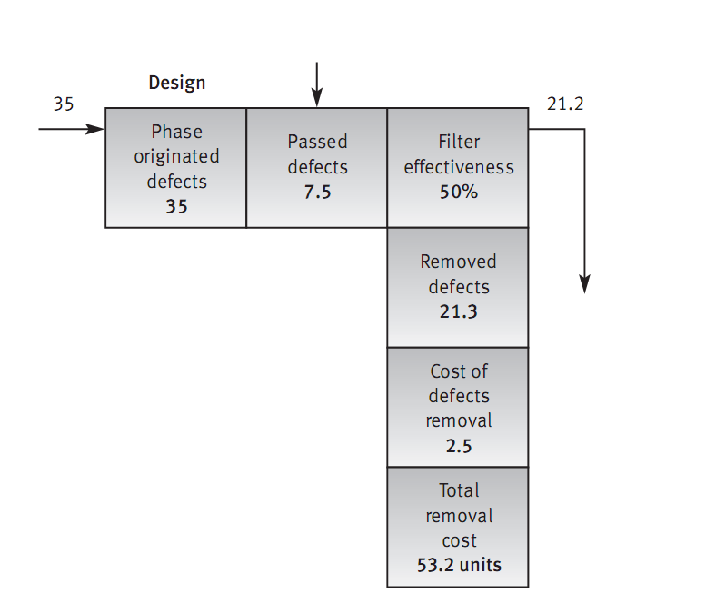
The model
POD = Phase Originated Defects (from Table 1)
PD = Passed Defects (from former phase or former quality assurance activity)
FE
RD
CDR
TRC

Slide 21
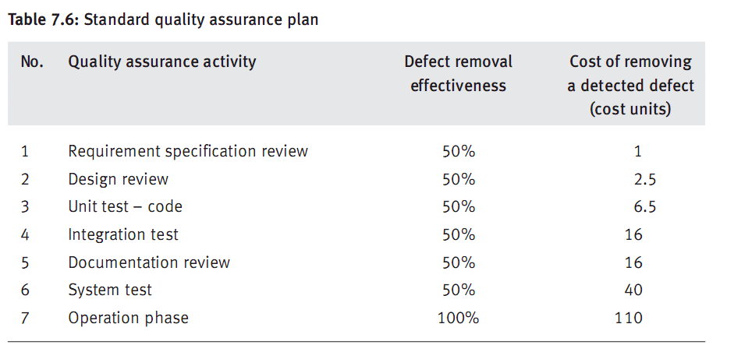
Example 1 Standard QA plan
The model applies to a standard quality assurance plan that is composed of six quality assurance activities as shown in Table .

Slide 22
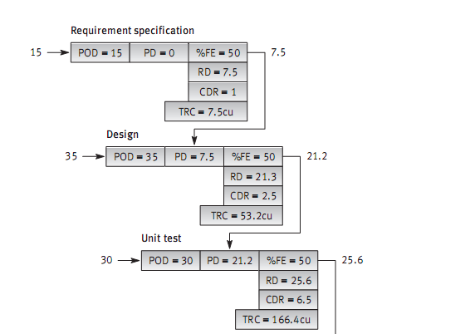
Example 1 standard QA plan(cont’)
Continue next slide

Slide 23
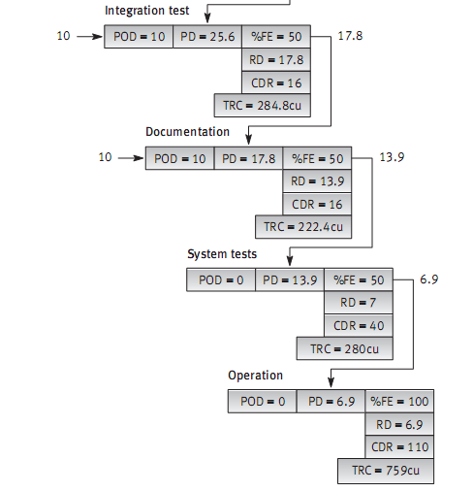
Example 1 standard QA plan(cont’)

Slide 24
Costs of Defect Removal
But we can do better using a comprehensive quality assurance plan with more activities, and hence better filtering.
The comprehensive quality assurance plan (comprehensive defects filtering system) accomplishes the following:
1. Adds two quality assurance activities so that the two are performed in the design phase as well as in the coding phase
We have a Design Inspection and a Design Review, and
Code Inspections and unit test
2. Improves the ‘filtering’ effectiveness of other quality assurance activities.

Slide 25
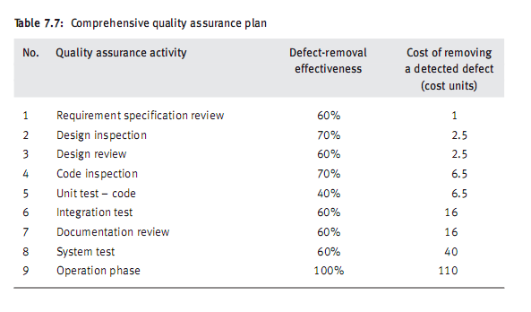
Example 2 comprehensive QA plan

Slide 26
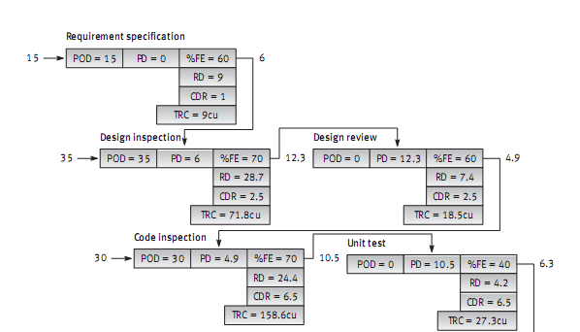
Example 2 comprehensive QA plan(cont’)
Continue next slide
Notes:
Next PD = POD + PD – RD
TRC = RD + CDR

Slide 27
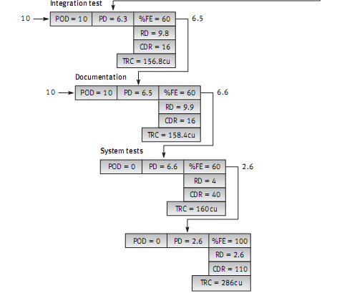
Example 2 comprehensive QA plan(cont’)

Slide 28
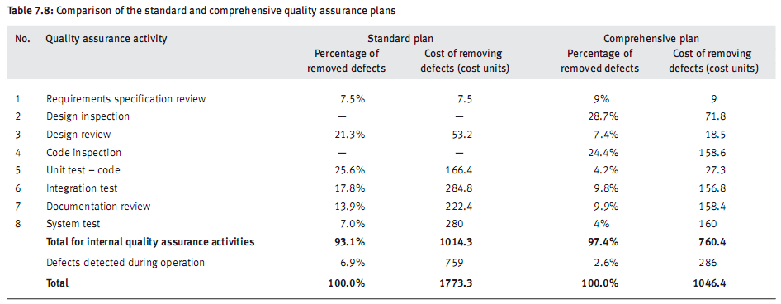
Comparison of the standard and comprehensive quality assurance plans

Slide 29
Conclusion:
The comprehensive plan as a whole is much more economical than the standard plan as it saves 41% of the total resources investing in defect removal, compared with the standard plan
Compared to the standard plan, the comprehensive plan makes a greater contribution to customer satisfaction by drastically reducing the rate of defects detected during regular operations: 6.9% to 2.6%

Slide 30
Reference
Chapter 7:Daniel Galin. SOFTWARE QUALITY ASSURANCE From theory to implementation. Pearson Education Limited,2004.

